Slide 1
Hidden Markov Models for
Speech Recognition (I)

Slide 2
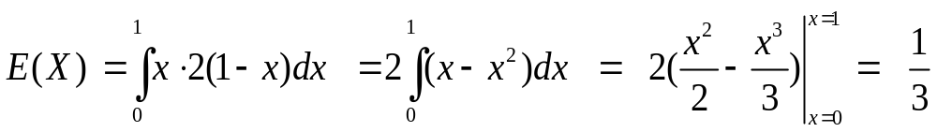
Review of Probability and Statistics
Expected Values
  expected (mean) value of c.r.v. X with p.d.f. f(x) is:
  example 1 (discrete):
  example 2 (continuous):
0.25
0.20
E(X) = 2·0.05+3·0.10+ … +8·0.1 = 5.3
0.15
0.15
0.05
0.10
0.1
1.0
2.0
3.0
4.0
5.0
6.0
7.0
8.0
9.0
where

Slide 3
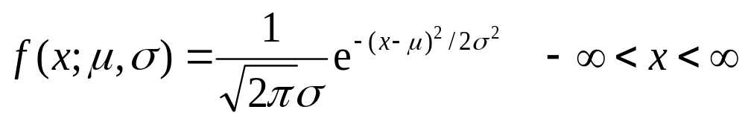
Review of Probability and Statistics
The Normal (Gaussian) Distribution
  the p.d.f. of a Normal distribution is
where μ is the mean and σ is the standard deviation
σ
μ
σ² is called the variance.

Slide 4
Review of Probability and Statistics
The Normal Distribution
  any arbitrary p.d.f. can be constructed by summing
  N weighted Gaussians (mixtures of Gaussians)
w₁
w₂
w₃
w₄
w₅
w₆
Reference: John-Paul Hosom, Lecture Notes for April 10, Review of Probability & Statistics; Markov Models

Slide 5
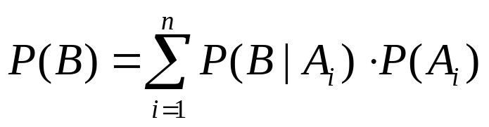
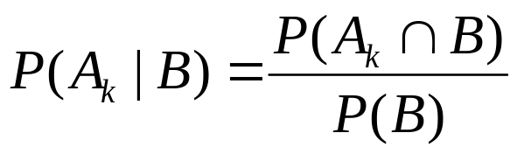
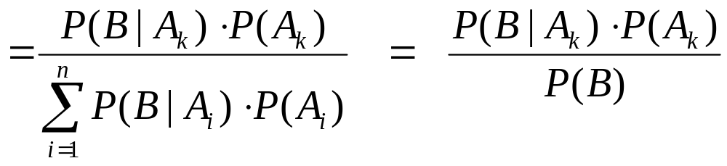
Review of Probability and Statistics
Law of Total Probability
  for independent events A₁, A₂, … A_{n} and any other event B:
Bayes’ Rule
  for independent events A₁, A₂, … A_{n} and any other event B,
  with P(A_{i}) > 0 and P(B) > 0:
Reference: John-Paul Hosom, Lecture Notes for April 10, Review of Probability & Statistics; Markov Models

Slide 6
Introduction
Hidden Markov Model (HMM)
  History
  Published in papers of Baum in late 1960s and early 1970s
  Introduced to speech processing by Baker (CMU) and Jelinek (IBM) in the 1970s
  Assumption
  Speech signal can be characterized as a parametric random process
  Parameters can be estimated in a precise, well-defined manner
  Three fundamental problems
  Evaluation of probability (likelihood) of a sequence of observations given a specific HMM
  Determination of a best sequence of model states
  Adjustment of model parameters so as to best account for observed signal
Reference: Jeih-weih Hung, Hidden Markov Models

Slide 7
Observable Markov Model
Another Example : Portland Winter Weather
0.7
0.5
0.25
S₁
S₂
0.4
0.2
0.7
0.05
0.1
S₃
0.1
Reference: John-Paul Hosom, Lecture Notes for April 10, Review of Probability & Statistics; Markov Models

Slide 8
Observable Markov Model
Example 3: Portland Winter Weather (con’t)
S₁ = event₁ = rain
S₂ = event₂ = clouds A = {a_{ij}} =
S₃ = event₃ = sun
what is probability of {rain, rain, rain, clouds, sun, clouds, rain}?
Obs. = {r, r, r, c, s, c, r}
S = {S₁, S₁, S₁, S₂, S₃, S₂, S₁}
time = {1, 2, 3, 4, 5, 6, 7} (days)
= P[S₁] P[S₁|S₁] P[S₁|S₁] P[S₂|S₁] P[S₃|S₂] P[S₂|S₃] P[S₁|S₂]
= 0.5 · 0.7 · 0.7 · 0.25 · 0.1 · 0.7 · 0.4
= 0.001715
Reference: John-Paul Hosom, Lecture Notes for April 10, Review of Probability & Statistics; Markov Models

Slide 9
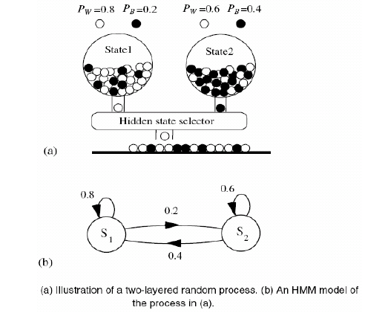
Hidden Markov Model

Slide 10
Hidden Markov Model
HMM, an extended version of OMM
  The observation is turned to be a probabilistic function (discrete or continuous) of a state instead of an one-to-one correspondence of a state
  The model is a doubly embedded stochastic process with an underlying stochastic process that is not directly observable (hidden)
    What is hidden? The State Sequence!
    According to the observation sequence, we are not sure which state sequence generates it!
Elements of an HMM (State-output HMM) {S,A,B,π}
  S is a set of N states
  A is the NN matrix of transition probabilities between states
  B is a set of N probability functions, each describing the observation probability with respect to a state (further discussed later)
  π is the vector of initial state probability
From Jeih-weih Hung

Slide 11
Practical HMMs for Speech
Each state can be associated with
□ sub-phoneme
□ phoneme
□ sub-word
Usually, sub-phonemes or sub-words are used, to account
for coarticulation (spectral dynamics).
One HMM corresponds to one phoneme or word
For each HMM, determine the most likely state sequence that
results in the observed speech.
Choose HMM with best match to observed speech.
Given most likely HMM and state sequence, determine the
corresponding phoneme and word sequence (simple).
Reference: John-Paul Hosom, Lecture Notes for April 24: HMMs for speech; review anatomy/framework of HMM; start Viterbi search

Slide 12
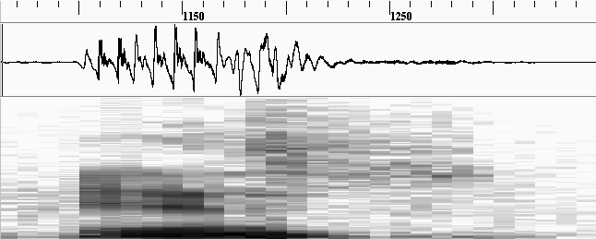
Practical HMMs for Speech
Example of using HMM for word “yes” on an utterance:
o₁
o₂
o₃
o₄
o₅
o₆
o₇
o₈
o₂₉
0.6
0.3
0.5
0.8
1.0
sil
0.4
y
0.7
eh
0.5
s
0.2
sil
b_{sil}(o₁)·0.6·b_{sil}(o₂)·0.6·b_{sil}(o₃)·0.6·b_{sil}(o₄)·0.4·b_{y}(o₅)·0.3·b_{y}(o₆)·0.3·b_{y}(o₇)·0.7 ...
observation
state
Reference: John-Paul Hosom, Lecture Notes for April 24: HMMs for speech; review anatomy/framework of HMM; start Viterbi search

Slide 13
The Three Basic Problems for HMMs
Problem 1 (Evaluation): Given the observation sequence O=(o₁o₂…o_{T}), and an HMM model Φ = (A,B,π), how do we efficiently compute P(O| Φ), the probability of the observation sequence, given the model
⇨ Evaluation problem
Problem 2 (Decoding): Given the observation sequence O=(o₁o₂…o_{T}), and an HMM model Φ = (A,B,π), how do we choose a corresponding state sequence Q=(q₁q₂…q_{T}) that is optimal in some sense (i.e., best explains the observations)
⇨ Optimality Criterion
Problem 3 (Learning): How do we adjust the model parameters Φ = (A,B,π) to maximize P(O| Φ )?
⇨ Optimizing Model Parameters

Slide 14
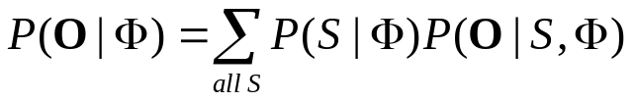
The Evaluation Problem
Given observation sequence O and HMM Φ, compute P(O| Φ)
Why is this hard? Sum over all possible sequences of states!
q2
P(o1o2o3|q0q0q0)
+
P(o1o2o3|q0q0q1)
+
P(o1o2o3|q0q1q2)
+
P(o1o2o3|q0q1q0)
…
q1
q0
q2
q2
q1
q0
q1
q0
q0
q2
q1
q0
o1
o2
o3
o4
oT
Why can’t we do an explicit sum over all paths?
Because it’s intractable. O(N^{T})
Reference: John-Paul Hosom, Lecture Notes for April 24: HMMs for speech; review anatomy/framework of HMM; start Viterbi search

Slide 15
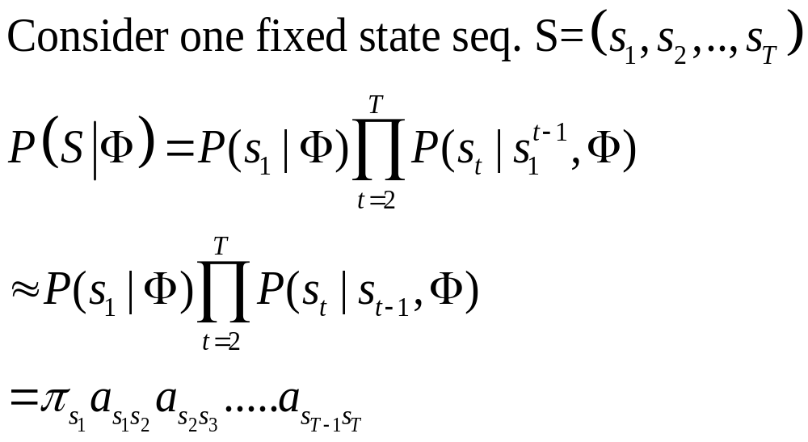
The Evaluation Problem (cont.)
The probability of each path S
• By Markov assumption (First-order HMM)
By chain rule
By Markov Assumption

Slide 16
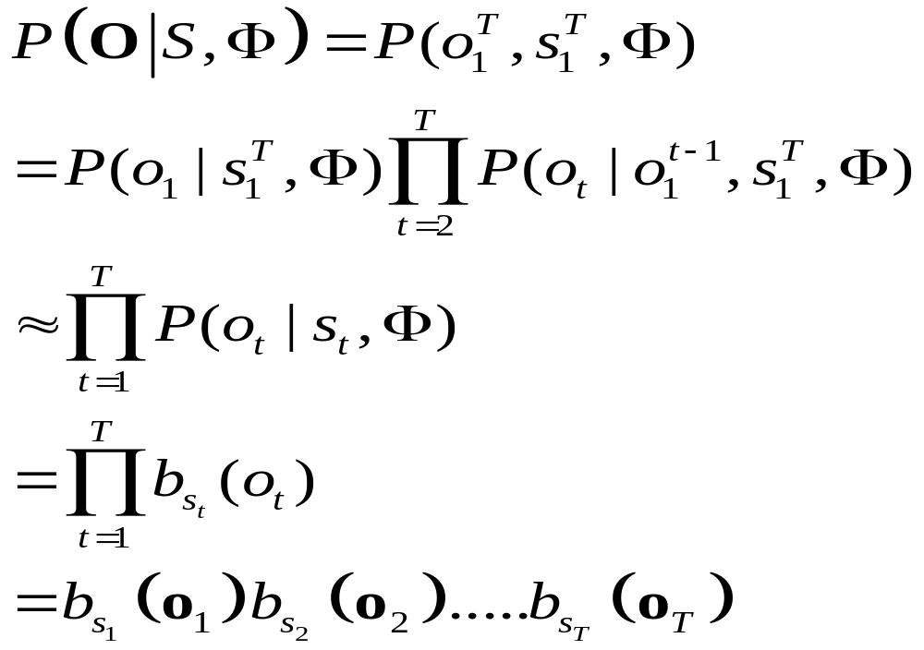
The Evaluation Problem (cont.)
By output-independent assumption
  The probability that a particular observation symbol/vector is emitted at time t depends only on the state s_{t} and is conditionally independent of the past observations

Slide 17
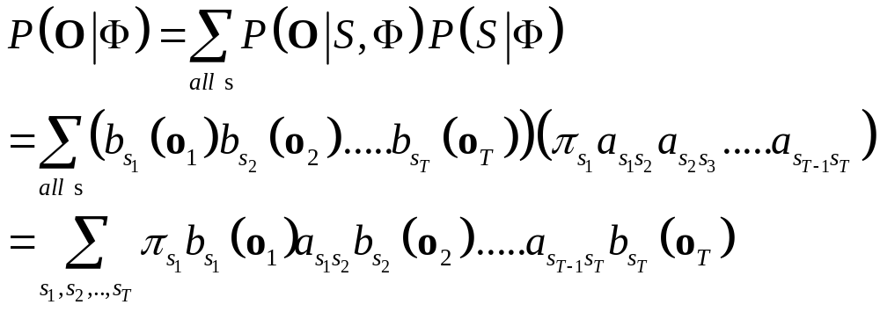
The Evaluation Problem (cont.)
A more efficient algorithms can be used to evaluate:
The Forward Algorithm. O(N²T)

Slide 18
The Evaluation Problem (cont.)
The probability of the observations corresponding to a certain state sequence:
State
s₁
s₁
s₁
s₁
s₁
s₂
s₂
s₂
s₂
s₂
s₃
s₃
s₃
s₃
s₃
1 2 3 T-1 T time
O₁
O₂
O₃
O_{T-1}
O_{T}
s_{i}
means P(s_{i},o_{t}|Φ) has been computed
a_{ij}
means a_{ij} has been computed

Slide 19
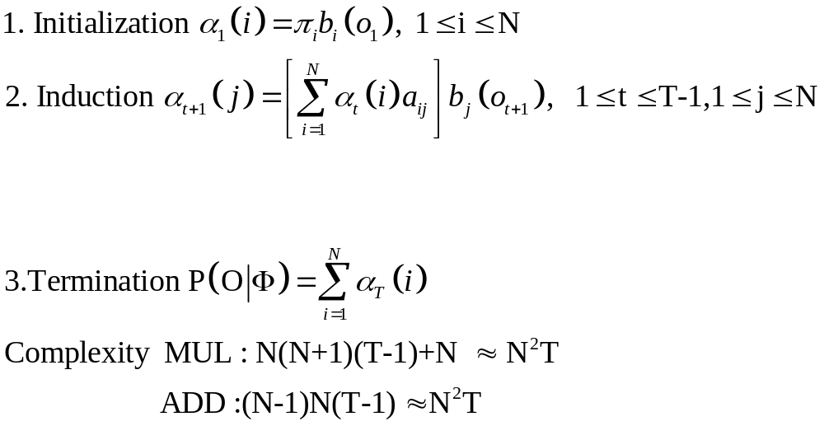
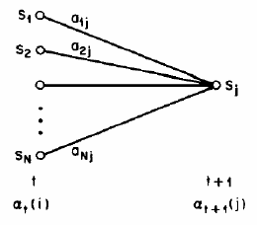
The Evaluation Problem (cont.)
Solution to Problem 1 -Probability Evaluation (Cont.)
  The forward Procedure
  forward variable : α_{t}(i)=P(o₁,o₂,…..,o_{t},q_{t}=i|Λ)
    Based on the lattice (trellis) structure
    All state sequence will remerge into these N nodes (states) no matter how long the observation sequence

Slide 20
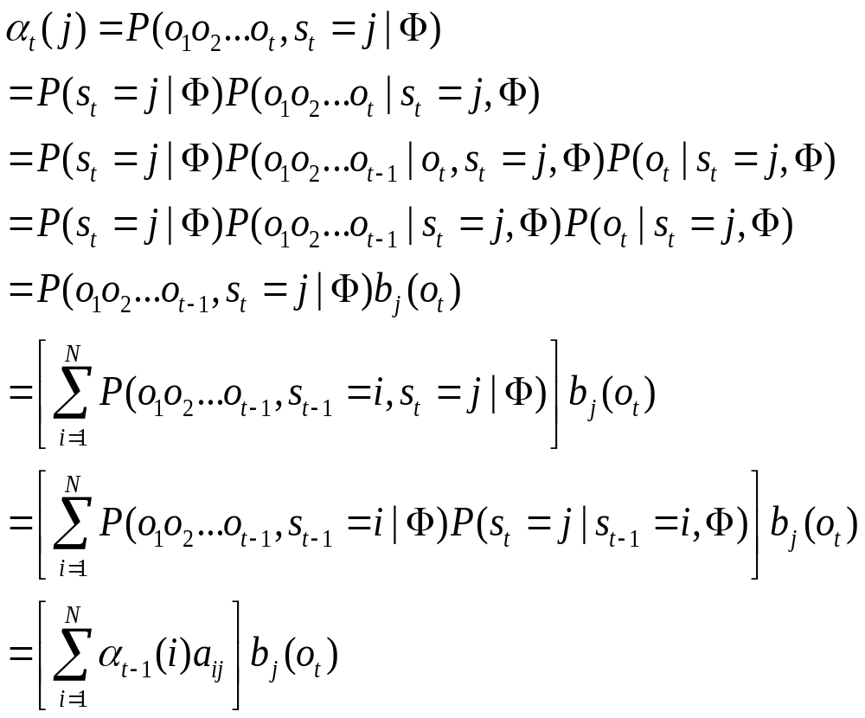
The Evaluation Problem (cont.)

Slide 21
Forward Procedure
α₃(1)=P(o₁,o₂,o₃,q₃=1| Φ)
State
s₁
s₁
s₁
s₁
s₁
s₂
s₂
s₂
s₂
s₂
s₃
s₃
s₃
s₃
s₃
1 2 3 T-1 T time
O₁
O₂
O₃
O_{T-1}
O_{T}
s_{i}
means P(s_{i},o_{t}|Φ) has been computed
a_{ij}
means a_{ij} has been computed

Slide 22
Forward Procedure
α₃(1)=P(o₁,o₂,o₃,s₃=1| Φ)= [α₂(1)*a₁₁+ α₂(2)*a₂₁+α₂(3)*a₃₁]b₁(o₃)
State
s₁
s₁
s₁
s₁
s₁
s₁
s₁
s₁
s₁
s₁
s₂
s₂
s₂
s₂
s₂
s₂
s₂
s₂
s₂
s₃
s₃
s₃
s₃
s₃
s₃
s₃
s₃
s₃
1 2 3 T-1 T time
O₁
O₂
O₃
O_{T-1}
O_{T}

Slide 23
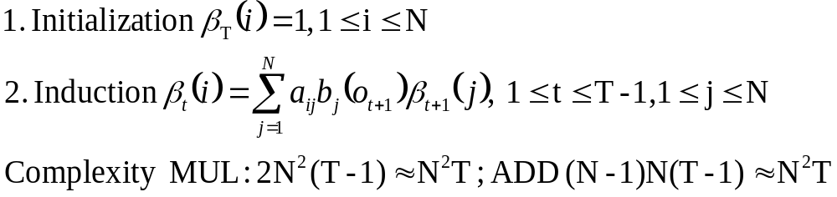
Problem 1 of HMM
Another Solution to Problem 1 –Probability Evaluation (Cont.)
  The backward Procedure

Slide 24
Backward procedure
β₂(1)=P(o₃,o₄,…, o_{T}|q₂=1,Φ)
State
s₁
s₁
s₁
s₁
s₁
s₁
s₂
s₂
s₂
s₂
s₂
s₂
s₃
s₃
s₃
s₃
s₃
s₃
1 2 3 T-1 T time
O₁
O₂
O₃
O_{T-1}
O_{T}
s_{i}
means P(s_{i},o_{t}|Φ) has been computed
a_{ij}
means a_{ij} has been computed

Slide 25
Backward procedure
β₂(1)=P(o₃,o₄,…, o_{T}|s₂=1,Φ)
=a₁₁* b₁(o₃)*β₃(1) +a₁₂* b₂(o₃)*β₃(2)+a₁₃* b₁(o₃)*β₃(3)
State
s₁
s₁
s₁
s₁
s₁
s₁
s₁
s₁
s₁
s₁
s₁
s₁
s₁
s₁
s₁
s₁
s₂
s₂
s₂
s₂
s₂
s₂
s₂
s₂
s₂
s₂
s₂
s₂
s₂
s₂
s₂
s₂
s₃
s₃
s₃
s₃
s₃
s₃
s₃
s₃
s₃
s₃
s₃
s₃
s₃
s₃
s₃
s₃
1 2 3 T-1 T time
O₁
O₂
O₃
O_{T-1}
O_{T}

Slide 26
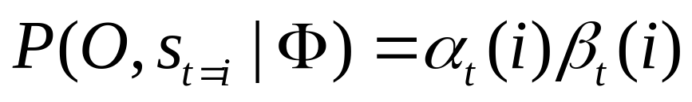
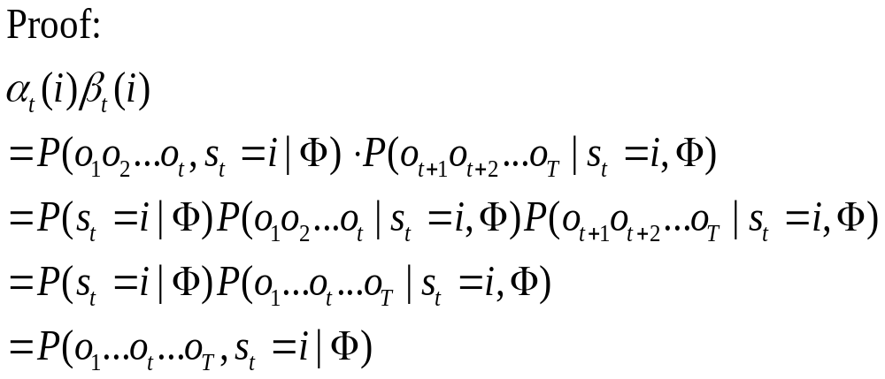
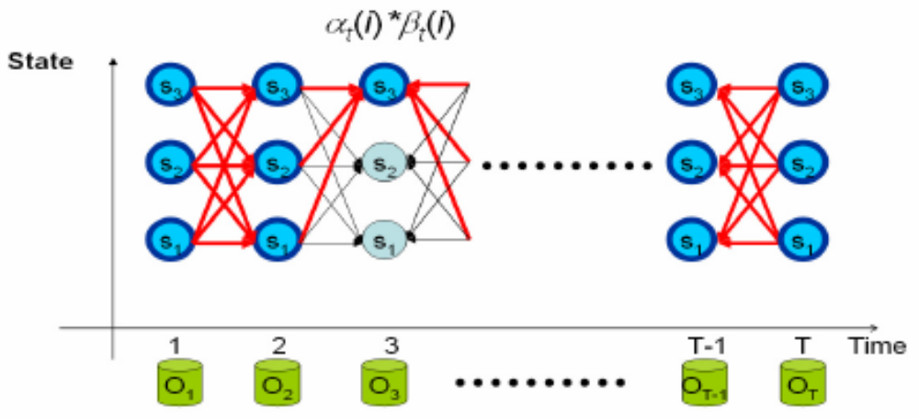
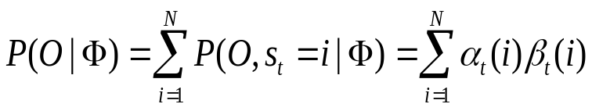
Forward-Backward Procedure

Slide 27
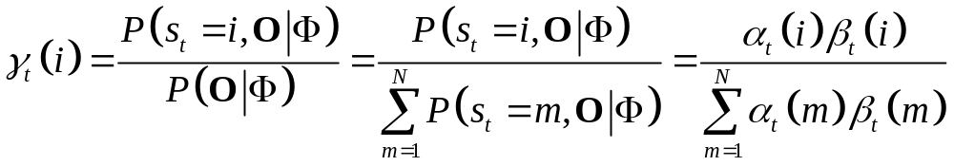
Problem 2 of HMM
Problem 2 :How to choose an optimal state sequence S=(s₁,s₂,……, s_{T}) ?
  The first optimal criterion : choose the states q_{t} are individually most likely at each time t
  Define a posteriori probability variable γ_{t}(i)= P(q_{t} = i | O,Φ)
    Solution : s_{t}* = arg_{i} max [γ_{t}(i)], 1 ≤ t ≤ T
    Problem: maximizing the probability at each time t individually
    S*= s₁*s₂*…s_{T}* may not be a valid sequence (e.g. a_{st*st+1*} = 0)

Slide 28
Problem 2 of HMM
P(q₃ = 1 ,O |Φ)
State
s₁
s₁
s₁
s₁
s₁
s₁
s₁
s₁
s₂
s₂
s₂
s₂
s₂
s₂
s₂
s₂
s₃
s₃
s₃
s₃
s₃
s₃
s₃
s₃
1 2 3 T-1 T time
O₁
O₂
O₃
O_{T-1}
O_{T}

Slide 29
Problem 2 of HMM
P(s₃ = 1 ,O |Φ)=α₃(1)*β₃(1)
α3(1)
β3(1)
State
s₁
s₁
s₁
s₁
s₁
s₁
s₁
s₁
s₁
s₁
s₂
s₂
s₂
s₂
s₂
s₂
s₂
s₂
s₂
s₂
s₃
s₃
s₃
s₃
s₃
s₃
s₃
s₃
s₃
s₃
1 2 3 T-1 T time
O₁
O₂
O₃
O_{T-1}
O_{T}

Slide 30
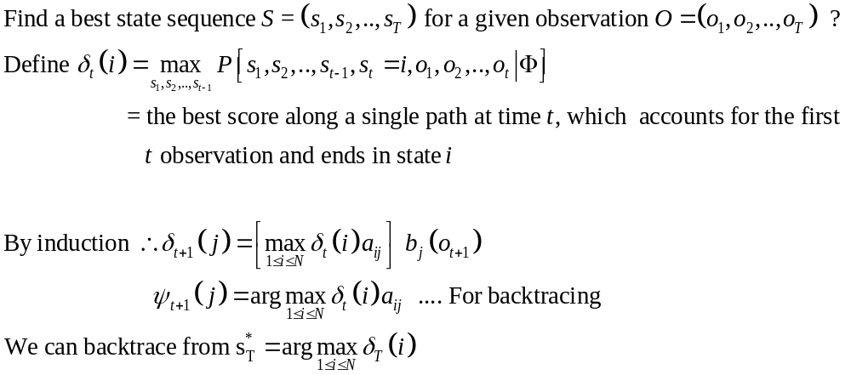
Problem 2 of HMM
Problem 2 :How to choose an optimal state sequence S=(s₁,s₂,……, s_{T}) ?
The Viterbi Algorithm

Slide 31
Problem 2 of HMM
The Viterbi Algorithm
State
s₁
s₁
s₁
s₁
s₁
s₂
s₂
s₂
s₂
s₂
s₃
s₃
s₃
s₃
s₃
1 2 3 T-1 T time
O₁
O₂
O₃
O_{T-1}
O_{T}

Slide 32

Installation of HTK
HTK - Hidden Markov Toolkit
Website: http://htk.eng.cam.ac.uk/

Slide 33

Registration
The first step is registration

Slide 34

download
Download HTK
  http://htk.eng.cam.ac.uk/download.shtml

Slide 35
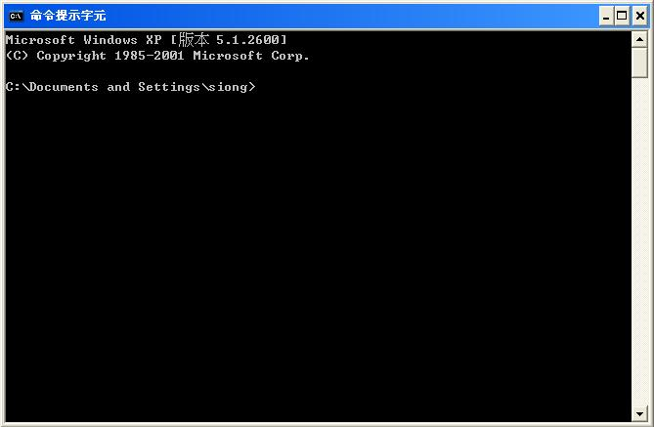
Compiling HTK
Install VC or VS
Unpack the HTK sources
Open a command mode and cd into the directory of your HTK sources

Slide 36
Compiling HTK(cont.)
Run VCVARS32

